Slide 1
SOCIAL QUIZ-TANCING

Slide 3
General

Slide 4
General
1) Which animal is represented by a clarinet in “Peter and the Wolf”?

Slide 5
General
2) What animal is the mascot of the US Naval Academy?

Slide 6
General
3) What do the 4 “H”’s stand for in 4H Club?
Notes:
in philly

Slide 7
General
4) This week in history, 1683: Dutch scientist ___________ is the first to report the existence of bacteria

Slide 8
General
5) What is the number 5 in binary?
Notes:
Nelson Mandela

Slide 9
General
6) Which country has the world’s longest cave system?
Notes:
Bjork

Slide 10
General
7) What’s Dorothy’s last name in The Wizard of Oz?
Notes:
Nelson Mandela

Slide 11
General
8) The Polo clothing brand was started by which American designer?
Notes:
Cuba

Slide 12
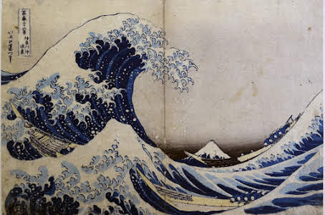
General
9) Which artist painted the work shown here?

Slide 13
General
10) How much does it cost to mail a postcard within the US?

Slide 14
Answers

Slide 15
The cat
1) Which animal is represented by a clarinet in “Peter and the Wolf”?

Slide 16
Goat
2) What animal is the mascot of the US Naval Academy?

Slide 17
Head, heart, hands, health
3) What do the 4 “H”’s stand for in 4H Club?
Notes:
in philly

Slide 18
Antonie van Leeuwenhoek
4) This week in history, 1683: Dutch scientist ___________ is the first to report the existence of bacteria

Slide 19
101
5) What is the number 5 in binary?
Notes:
Nelson Mandela

Slide 20
USA (Mammoth State Park, KY)
6) Which country has the world’s longest cave system?
Notes:
Bjork

Slide 21
Gale
7) What’s Dorothy’s last name in The Wizard of Oz?
Notes:
Nelson Mandela

Slide 22
Ralph Lauren
8) The Polo clothing brand was started by which American designer?
Notes:
Cuba

Slide 23
Hokusai
9) Which artist painted the work shown here?

Slide 24
35 cents
10) How much does it cost to mail a postcard within the US?

Slide 25
Produce | Board games | Band names | National dishes
1 | 1 | 1 | 1
2 | 2 | 2 | 2
3 | 3 | 3 | 3
4 | 4 | 4 | 4
5 | 5 | 5 | 5

Slide 26
Produce

Slide 27
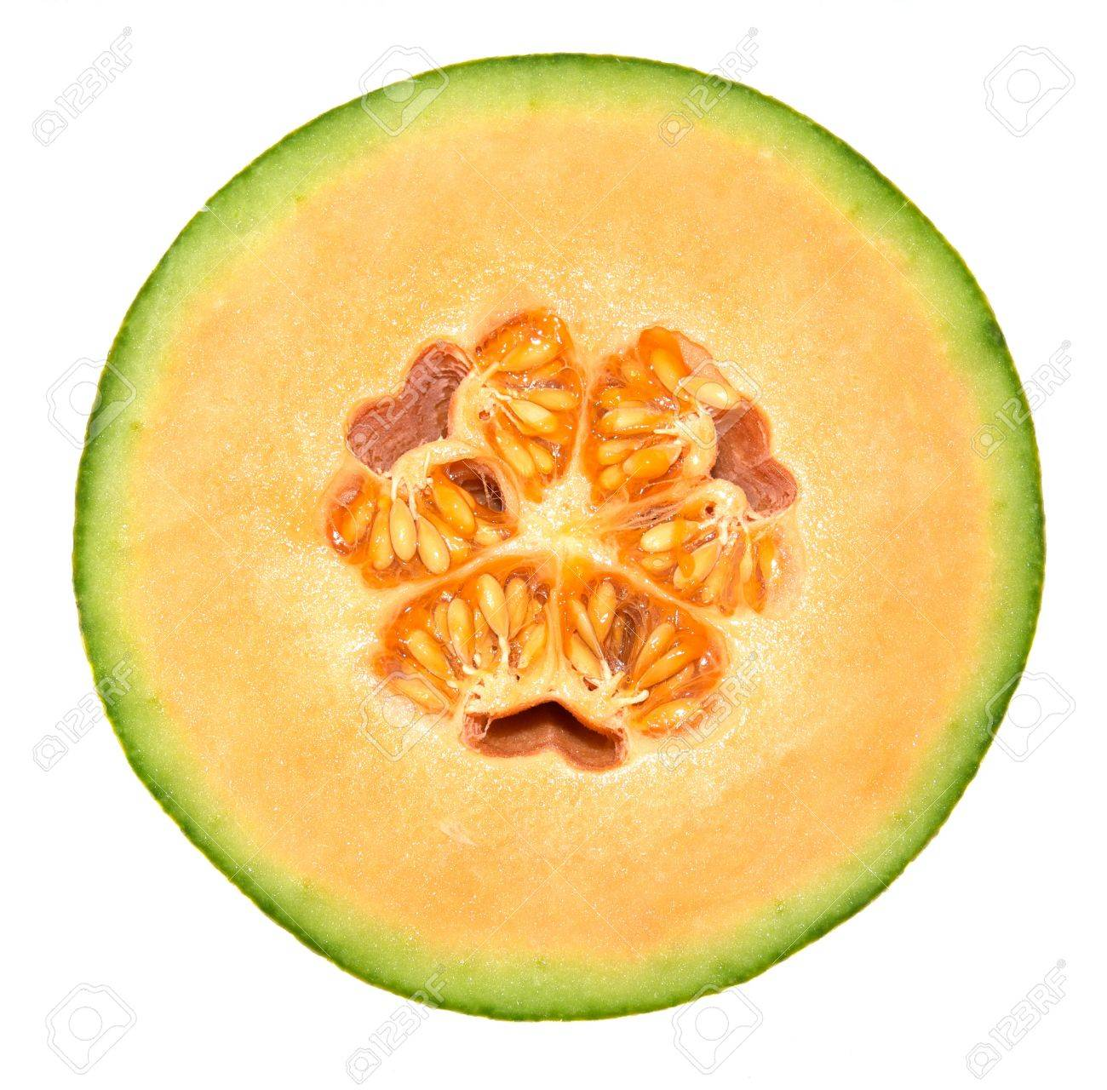
Produce

Slide 28
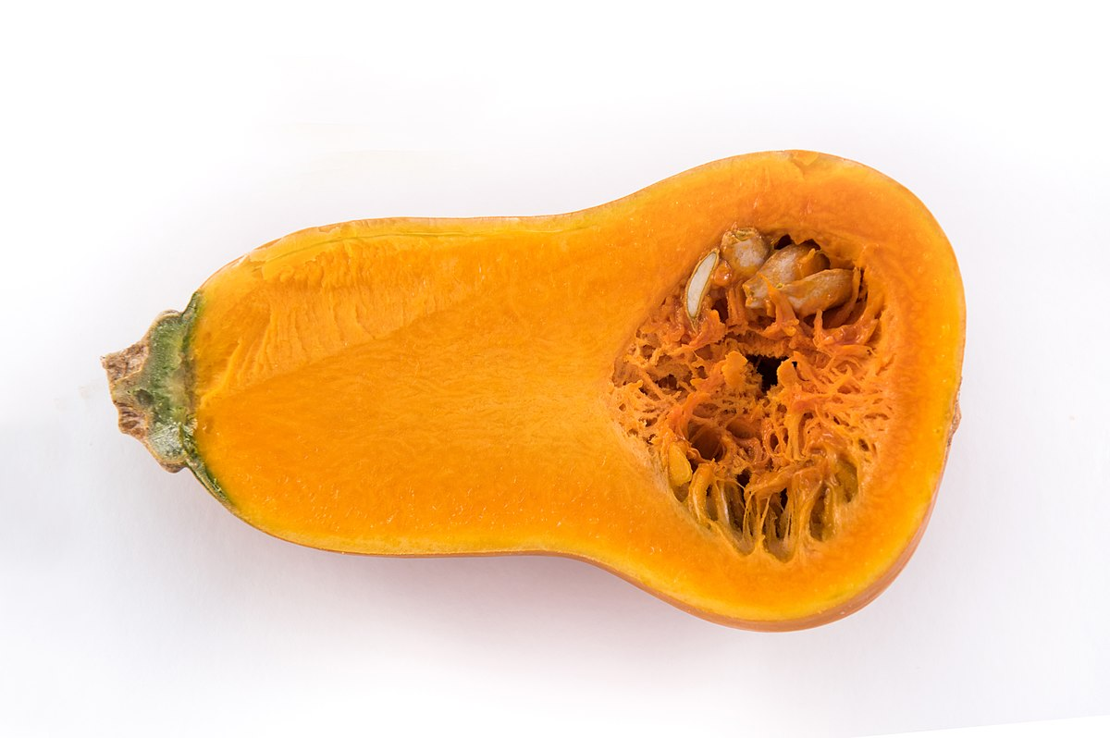
Produce

Slide 29
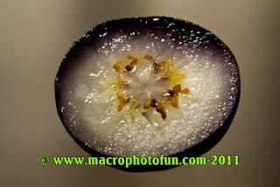
Produce

Slide 30
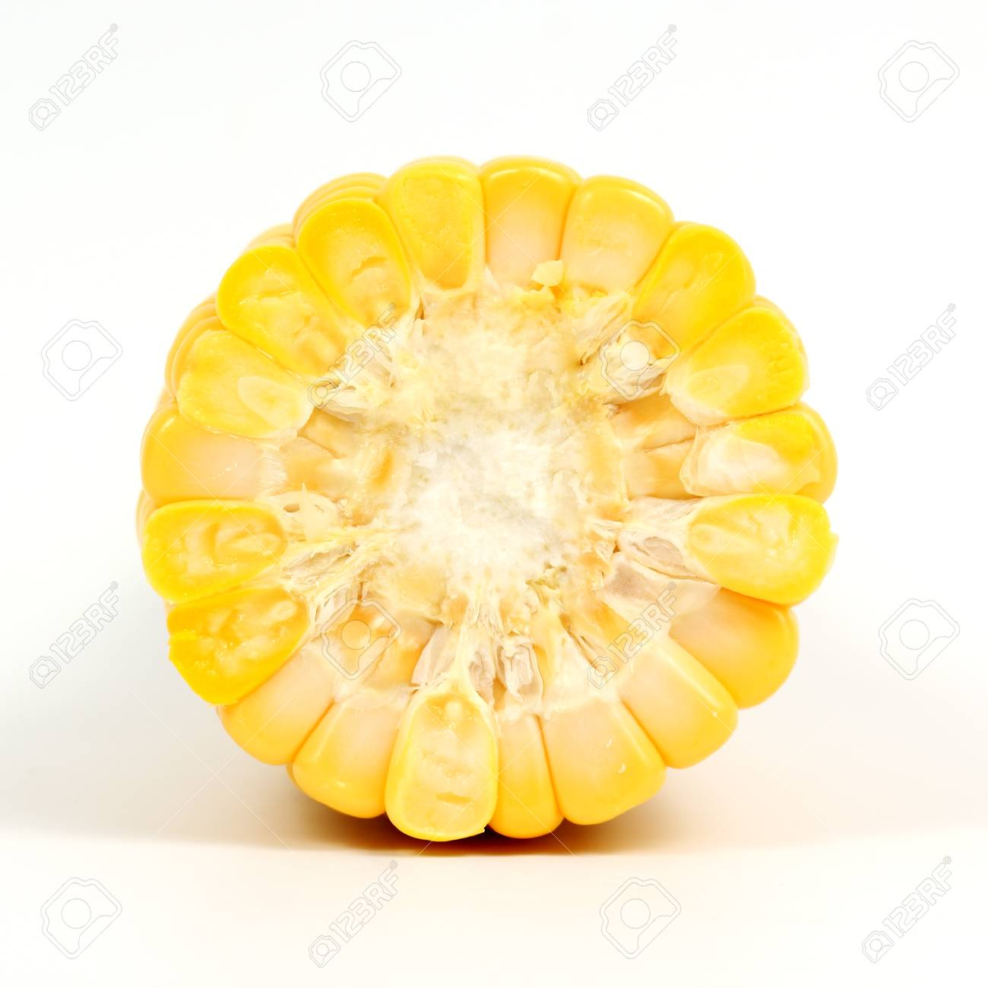
Produce

Slide 31
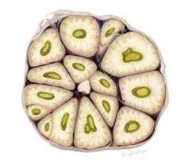
Produce

Slide 32
Board games

Slide 33
Board games
“B6?”
“Miss!”

Slide 34
Board games
“I’ll trade you some wood for sheep”

Slide 35
Board games
“Mrs. Peacock in the observatory with the bat”

Slide 36
Board games
“I’m taking over South America and there ain’t nothin’ you can do about it!”

Slide 37
Board games
“I’m building a research station”

Slide 38
Band names

Slide 39
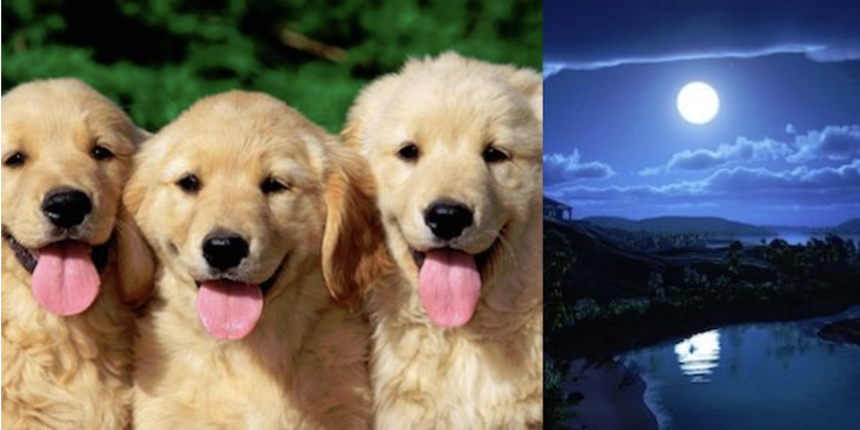
Band names

Slide 40
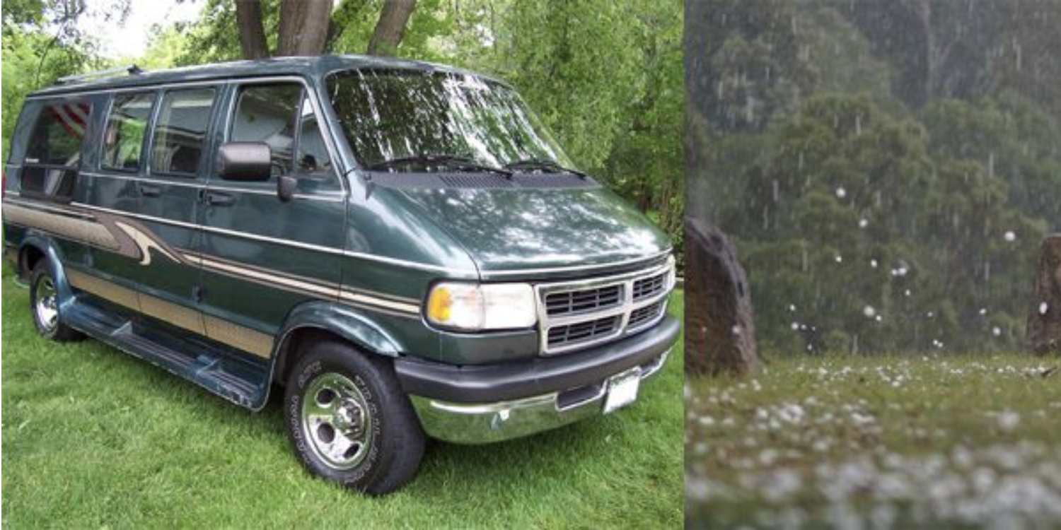
Band names

Slide 41
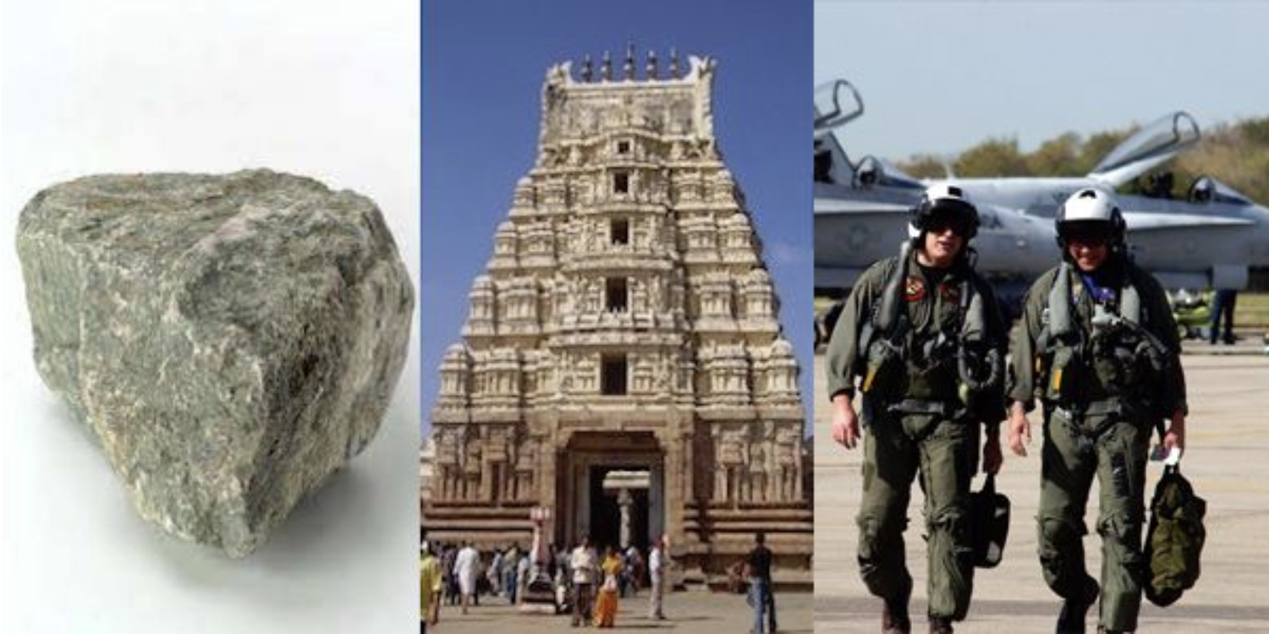
Band names

Slide 42
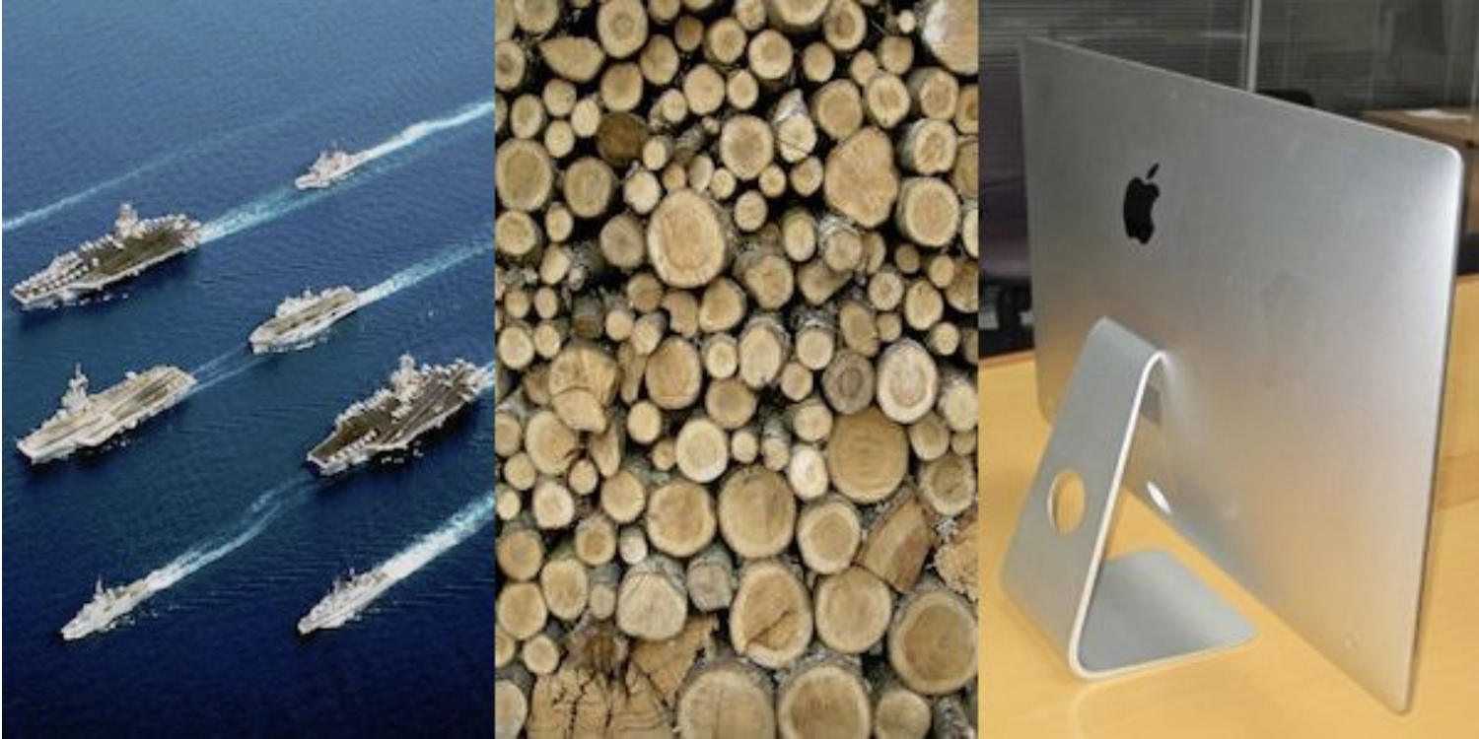
Band names

Slide 43
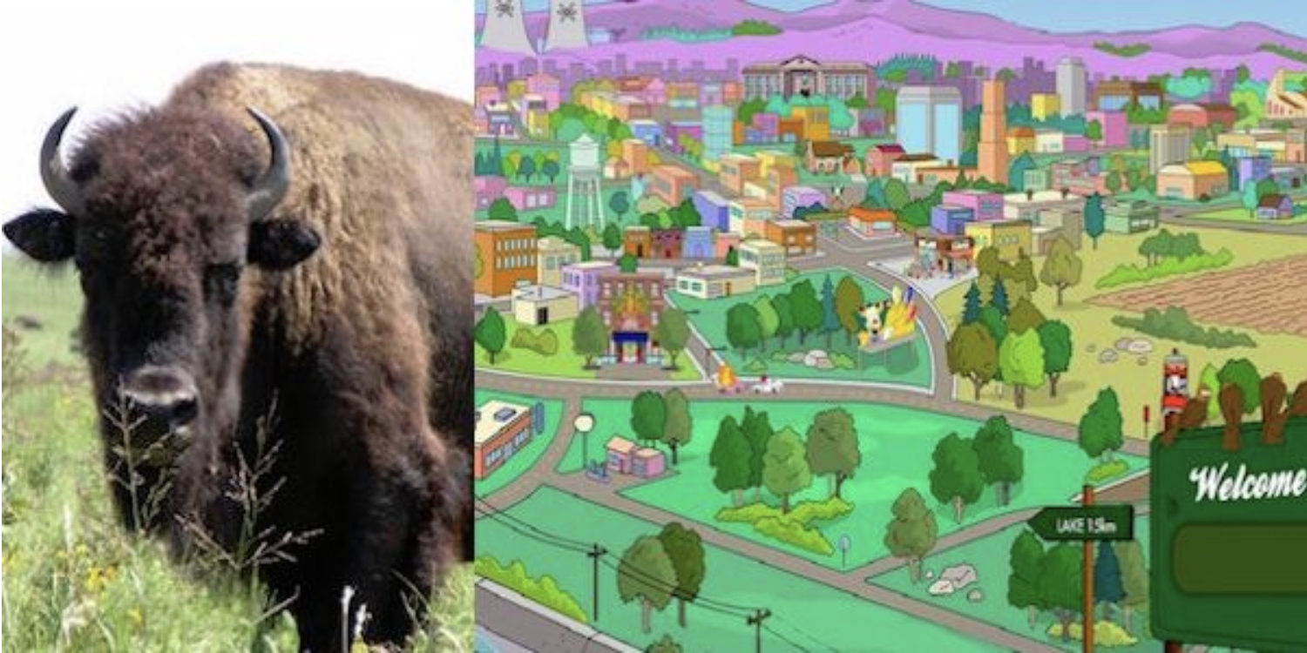
Band names

Slide 44
National dishes

Slide 45
National dishes
Chicken Tikka Masala

Slide 46
National dishes
Falafel

Slide 47
National dishes
Tagine

Slide 48
National dishes
Chicken Adobo

Slide 49
National dishes
Paella

Slide 50
Answers

Slide 51
Produce

Slide 52
Cantaloupe

Slide 53
Butternut squash

Slide 54
Blueberry

Slide 55
Corn

Slide 56
Garlic

Slide 57
Board games

Slide 58
Battleship
“B6?”
“Miss!”

Slide 59
Settlers of Catan
“I’ll trade you some wood for sheep”

Slide 60
Clue
“Mrs. Peacock in the observatory with the bat”

Slide 61
Risk (quote from Seinfeld)
“I’m taking over South America and there ain’t nothin’ you can do about it!”

Slide 62
Pandemic (or the Star Trek version of Settlers of Catan)
“I’m building a research station”

Slide 63
Band names

Slide 64
Three Dog Night

Slide 65
Van Halen

Slide 66
Stone Temple Pilots

Slide 67
Fleetwood Mac

Slide 68
Buffalo Springfield

Slide 69
National dishes

Slide 70
England
Chicken Tikka Masala

Slide 71
Israel
Falafel

Slide 72
Morocco
Tagine

Slide 73
Philippines
Chicken Adobo

Slide 74
Spain
Paella

Slide 75
Matching

Slide 76
Constellations
Antares
Polaris
Betelgeuse
Vega
Arcturus
Ursa Minor
Orion
Scorpio
Cassiopeia
Boötes
Lyra
Notes:
Written specifically about that topic or event
Born in the USA: also vietnam war vets
This Land is Your Land: response to God Bless America

Slide 77
Sports fouls
Hooking
Net serving
Travelling
False Start
No foot on the floor
American football
Hockey
Golf
Basketball
Billiards
Volleyball

Slide 78
Lists

Slide 79
5 states with the lowest voter turnout in 2016

Slide 80
5 wives of Henry VIII

Slide 81
Answers

Slide 82
Matching

Slide 83
Constellations
Antares
Scorpio
Polaris
Ursa Minor
Betelgeuse
Orion
Vega
Lyra
Arcturus
Boötes

Slide 84
Sports fouls
Hooking
Hockey
Net serving
Volleyball
Travelling
Basketball
False Start
American football
No foot on the floor
Billiards

Slide 85
Lists

Slide 86
5 states with the lowest voter turnout in 2016
Hawai’i (42.5%)
Utah (46.4%)
West Virginia (51.0%)
Tennessee (51.0%)
Texas (51.1%)

Slide 87
5 wives of Henry VIII
Catherine of Aragon
Anne Boleyn
Jane Seymour
Anne of Cleves
Catherine Howard
Catherine Parr

